Slide 1
Relevance Feedback
Hongning Wang
CS@UVa

Slide 2


What we have learned so far
Indexed corpus
Crawler
Ranking procedure
Research attention
Feedback
Evaluation
Doc Analyzer
(Query)
User
Query Rep
Doc Rep (Index)
Ranker
Indexer
results
Index

Slide 3


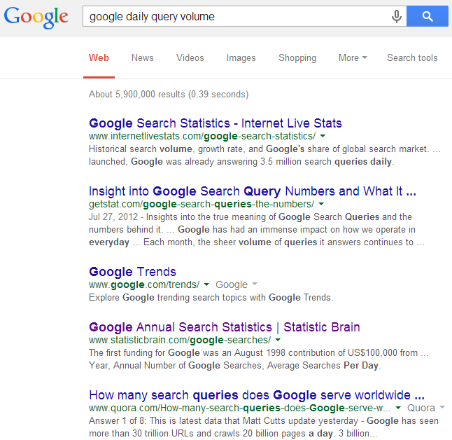
User feedback
should be
An IR system is an interactive system
Query
Information need
Feedback
GAP!
Ranked documents
Inferred information need

Slide 4
Relevance feedback
Results:
d₁ 3.5
d₂ 2.4
…
d_{k} 0.5
...
Query
Retrieval
Engine
User
judgment
Updated
query
Document
collection
Judgments:
d₁ +
d₂ -
d₃ ₊
…
d_{k} -
...
Feedback

Slide 5
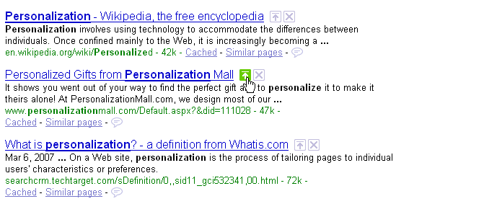
Relevance feedback in real systems
Google used to provide such functions
Guess why?
Relevant
Nonrelevant

Slide 6
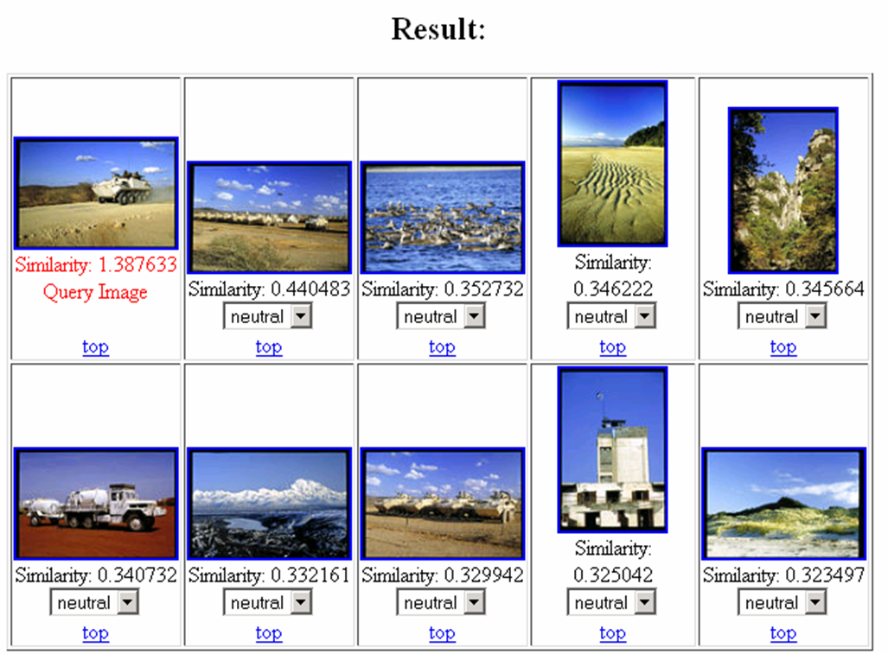
Relevance feedback in real systems
Popularly used in image search systems

Slide 7
Pseudo feedback
What if the users are reluctant to provide any feedback
Results:
d₁ 3.5
d₂ 2.4
…
d_{k} 0.5
...
Query
Retrieval
Engine
Updated
query
Document
collection
Judgments:
d₁ +
d₂ +
d₃ ₊
…
d_{k} -
...
top k
Feedback

Slide 8
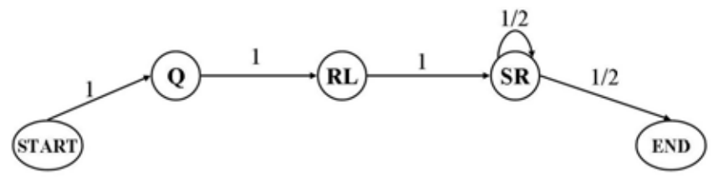
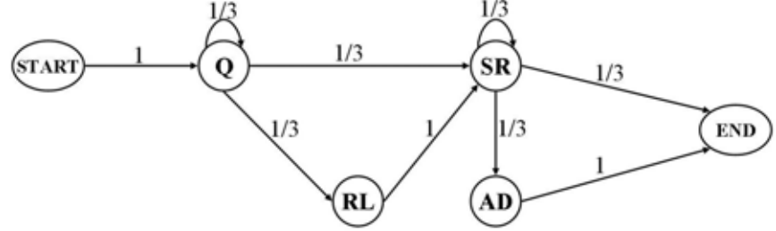
Recap: Beyond DCG: User Behavior as a Predictor of a Successful Search
Modeling users’ sequential search behaviors with Markov models
A model for successful search patterns
A model for unsuccessful search patterns
ML for parameter estimation on annotated data set

Slide 9
Recap: feedback in a search engine
Indexed corpus
Crawler
Ranking procedure
Feedback
Evaluation
Doc Analyzer
(Query)
User
Query Rep
Doc Rep (Index)
Ranker
Indexer
results
Index

Slide 10
Recap: relevance feedback
Results:
d₁ 3.5
d₂ 2.4
…
d_{k} 0.5
...
Query
Retrieval
Engine
User
judgment
Updated
query
Document
collection
Judgments:
d₁ +
d₂ -
d₃ ₊
…
d_{k} -
...
Feedback

Slide 11
Recap: pseudo feedback
What if the users are reluctant to provide any feedback
Results:
d₁ 3.5
d₂ 2.4
…
d_{k} 0.5
...
Query
Retrieval
Engine
Updated
query
Document
collection
Judgments:
d₁ +
d₂ +
d₃ ₊
…
d_{k} -
...
top k
Feedback

Slide 12
Basic idea in feedback
Query expansion
Feedback documents can help discover related query terms
E.g., query=“information retrieval”
Relevant or pseudo-relevant docs may likely share very related words, such as “search”, “search engine”, “ranking”, “query”
Expand the original query with such words will increase recall and sometimes also precision

Slide 13
Basic idea in feedback
Learning-based retrieval
Feedback documents can be treated as supervision for ranking model update
Will be covered in the lecture of “learning-to-rank”

Slide 14
Feedback techniques
Feedback as query expansion
Step 1: Term selection
Step 2: Query expansion
Step 3: Query term re-weighting
Feedback as training signal
Will be covered later in learning to rank

Slide 15
Relevance feedback in vector space models
General idea: query modification
Adding new (weighted) terms
Adjusting weights of old terms
The most well-known and effective approach is Rocchio ^{[Rocchio 1971]}

Slide 16
Illustration of Rocchio feedback
-
-
-
-
-
-
+
+
+
-
-
+
-
-
-
-
+
+
q
-
q
-
+
+
+
-
-
+
+
-
-
+
+
+
+
+
-
+
+
+
-
-
-
-
-
-
-
-

Slide 17
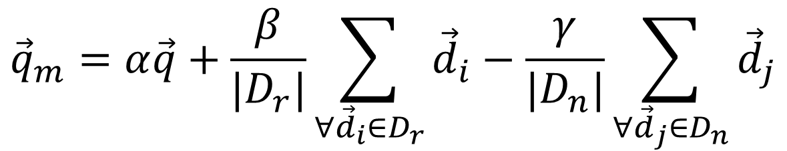
Formula for Rocchio feedback
Standard operation in vector space
Parameters
Modified query
$${\vec{q}}_{m}=α\vec{q}+\frac{β}{|D_{r}|}\sum_{∀{\vec{d}}_{i}∈D_{r}}{{\vec{d}}_{i}}−\frac{γ}{|D_{n}|}\sum_{∀{\vec{d}}_{j}∈D_{n}}{{\vec{d}}_{j}}$$
Original query
Rel docs
Non-rel docs

Slide 18
Rocchio in practice
Negative (non-relevant) examples are not very important (why?)
Efficiency concern
Restrict the vector onto a lower dimension (i.e., only consider highly weighted words in the centroid vector)
Avoid “training bias”
Keep relatively high weight on the original query
Can be used for relevance feedback and pseudo feedback
Usually robust and effective

Slide 19
Feedback in probabilistic models
Rel. doc model
Classic Prob. Model
NonRel. doc model
Language Model
“Rel. query” model
(q₁,d₁,1)
(q₁,d₂,1)
(q₁,d₃,1)
P(D|Q,R=1)
Initial retrieval:
- P(D|Q,R=1): query as rel doc
- P(Q|D,R=1): doc as rel query
Feedback:
- P(D|Q,R=1) can be improved for the current query and future doc
- P(Q|D,R=1) can be improved for the current doc and future query
(q₁,d₄,0)
(q₁,d₅,0)
(q₃,d₁,1)
P(D|Q,R=0)
Parameter
Estimation
(q₄,d₁,1)
(q₅,d₁,1)
(q₆,d₂,1)
(q₆,d₃,0)
P(Q|D,R=1)

Slide 20
Document generation model
Terms occur in doc
Terms do not occur in doc
Important tricks
Assumption: terms not occurring in the query are equally likely to occur in relevant and nonrelevant documents, i.e., p_{t}=u_{t}
document | relevant(R=1) | nonrelevant(R=0)
term present A_{i}=1 | p_{i} | u_{i}
term absent A_{i}=0 | 1-p_{i} | 1-u_{i}

Slide 21
Robertson-Sparck Jones Model (Robertson & Sparck Jones 76)
(RSJ model)
Two parameters for each term A_{i}:
p_{i} = P(A_{i}=1|Q,R=1): prob. that term A_{i} occurs in a relevant doc
u_{i} = P(A_{i}=1|Q,R=0): prob. that term A_{i} occurs in a non-relevant doc
How to estimate these parameters?
Suppose we have relevance judgments,
“+0.5” and “+1” can be justified by Bayesian estimation as priors
P(D|Q,R=1) can be improved for the current query and future doc
Per-query estimation!

Slide 22
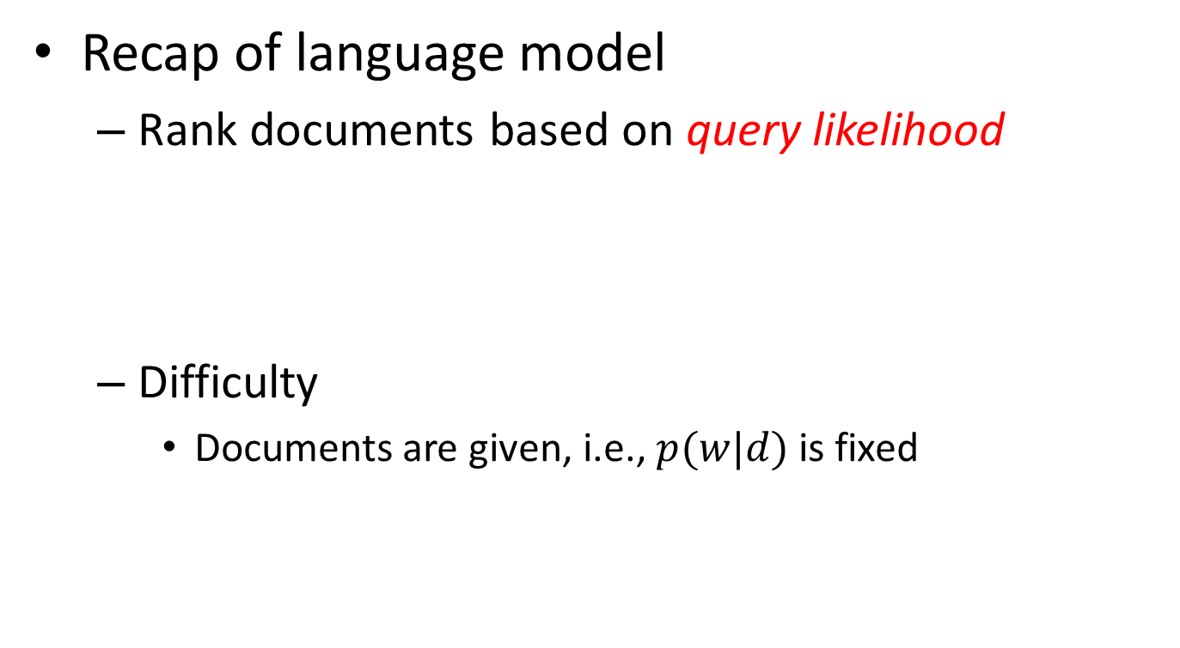
Feedback in language models
Recap of language model
Rank documents based on query likelihood
Difficulty
Documents are given, i.e., $p(w|d)$ is fixed
Document language model

Slide 23
Feedback in language models
Approach
Introduce a probabilistic query model
Ranking: measure distance between query model and document model
Feedback: query model update
Q: Back to vector space model?
A: Kind of, but in different perspective.

Slide 24
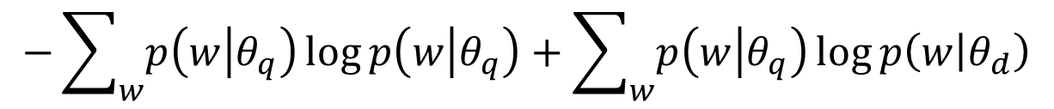

Kullback-Leibler (KL) divergence based retrieval model
Probabilistic similarity measure
$sim\left(q;d\right)∝−KL(θ_{q}|\left|θ_{d}\right)$
$$−\sum_{w}{p\left(w | θ_{q}\right)\log{p\left(w | θ_{q}\right)}}+\sum_{w}{p\left(w | θ_{q}\right)\log{p\left(w | θ_{d}\right)}}$$
Query-specific quality, ignored for ranking
Query language model, need to be estimated
Document language model, we know how to estimate

Slide 25

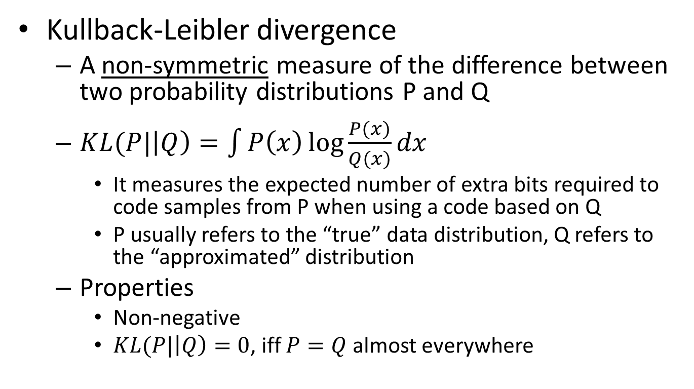
Background knowledge
Kullback-Leibler divergence
A non-symmetric measure of the difference between two probability distributions P and Q
$KL(P|\left|Q\right)=\int{P\left(x\right)\log{\frac{P(x)}{Q(x)}}dx}$
It measures the expected number of extra bits required to code samples from P when using a code based on Q
P usually refers to the “true” data distribution, Q refers to the “approximated” distribution
Properties
Non-negative
$KL(P|\left|Q\right)=0$, iff $P=Q$ almost everywhere
Explains why $sim\left(q;d\right)∝−D(θ_{q}|\left|θ_{d}\right)$

Slide 26
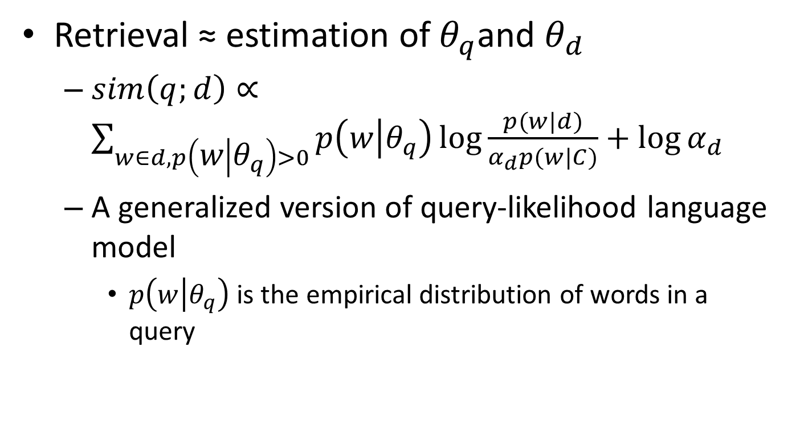
Kullback-Leibler (KL) divergence based retrieval model
Retrieval ≈ estimation of $θ_{q}$and $θ_{d}$
$sim\left(q;d\right)∝\sum_{w∈d,p\left(w | θ_{q}\right)>0}{p\left(w | θ_{q}\right)\log{\frac{p(w|d)}{α_{d}p(w|C)}}+\log{α_{d}}}$
A generalized version of query-likelihood language model
$p\left(w | θ_{q}\right)$ is the empirical distribution of words in a query
same smoothing strategy

Slide 27
Recap: illustration of Rocchio feedback
-
-
-
-
-
-
+
+
+
-
-
+
-
-
-
-
+
+
q
-
q
-
+
+
+
-
-
+
+
-
-
+
+
+
+
+
-
+
+
+
-
-
-
-
-
-
-
-

Slide 28
Recap: formula for Rocchio feedback
Standard operation in vector space
Parameters
Modified query
$${\vec{q}}_{m}=α\vec{q}+\frac{β}{|D_{r}|}\sum_{∀{\vec{d}}_{i}∈D_{r}}{{\vec{d}}_{i}}−\frac{γ}{|D_{n}|}\sum_{∀{\vec{d}}_{j}∈D_{n}}{{\vec{d}}_{j}}$$
Original query
Rel docs
Non-rel docs

Slide 29
Recap: feedback in Robertson-Sparck Jones Model
(RSJ model)
Two parameters for each term A_{i}:
p_{i} = P(A_{i}=1|Q,R=1): prob. that term A_{i} occurs in a relevant doc
u_{i} = P(A_{i}=1|Q,R=0): prob. that term A_{i} occurs in a non-relevant doc
How to estimate these parameters?
Suppose we have relevance judgments,
“+0.5” and “+1” can be justified by Bayesian estimation as priors
P(D|Q,R=1) can be improved for the current query and future doc
Per-query estimation!

Slide 30
Recap: KL divergence based retrieval model
Probabilistic similarity measure
$sim\left(q;d\right)∝−KL(θ_{q}|\left|θ_{d}\right)$
$$−\sum_{w}{p\left(w | θ_{q}\right)\log{p\left(w | θ_{q}\right)}}+\sum_{w}{p\left(w | θ_{q}\right)\log{p\left(w | θ_{d}\right)}}$$
Query-specific quality, ignored for ranking
Query language model, need to be estimated
Document language model, we know how to estimate

Slide 31
Feedback as model interpolation
Document D
Results
Query Q
Key: estimate the feedback model
Feedback Docs
F={d₁, d₂ , …, d_{n}}
α=0
α=1
Generative model
No feedback
Full feedback
Q: Rocchio feedback in vector space model?
A: Very similar, but with different interpretations.

Slide 32



Feedback in language models
Feedback documents
protect passengers, accidental/malicious harm, crime, rules

Slide 33
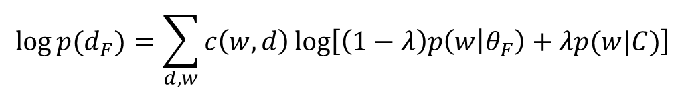

Generative mixture model of feedback
Background words
F={d₁, …, d_{n}}
λ
P(w| C)
P(feedback)
Topic words
1-λ
P(w| θ_{F} )
$$\log{p(d_{F})=\sum_{d,w}{c\left(w,d\right)\log\left[\left(1−λ\right)p\left(w | θ_{F}\right)+λp(w|C)\right]}}$$
λ = Noise ratio in feedback documents
Maximum Likelihood
$${ \overline{θ}}_{F}=argmax_{θ}\log{p(d_{F})}$$

Slide 34
How to estimate θ_{F}?
the 0.2
a 0.1
we 0.01
to 0.02
…
flight 0.0001
company 0.00005
…
fixed
Feedback
Doc(s)
Known
Background
p(w|C)
λ=0.7
ML
Estimator
Unknown
query topic
p(w|θ_{F})=?
“airport security”
…
accident =?
regulation =?
passenger=?
rules =?
…
λ=0.3
Suppose, we know the identity of each word
; but we don’t...

Slide 35
Appeal to Expectation Maximization algorithm
Identity (“hidden”) variable: z_{i} ∈{1 (background), 0(topic)}
z_{i}
1
1
1
1
0
0
0
1
0
...
Suppose the parameters are all known, what’s a reasonable guess of z_{i}?
- depends on λ (why?)
- depends on p(w|C) and p(w|θ_{F}) (how?)
the
paper
presents
a
text
mining
algorithm
the
paper
...
E-step
M-step
Why in Rocchio we did not distinguish a word’s identity?

Slide 36
A toy example of EM computation
Expectation-Step:
Augmenting data by guessing hidden variables
Maximization-Step
With the “augmented data”, estimate parameters using maximum likelihood
Assume λ=0.5

Slide 37
Example of feedback query model
Open question: how do we handle negative feedback?
Query: “airport security”
Pesudo feedback with top 10 documents
λ=0.7
λ=0.9

Slide 38
What you should know
Purpose of relevance feedback
Rocchio relevance feedback for vector space models
Query model based feedback for language models

